Slide 1
Rockefeller University Press and ORCID
September 30, 2025
Rob O’Donnell
Senior Director of Publishing
Rockefeller University Press
0000-0002-8112-769X

Slide 2


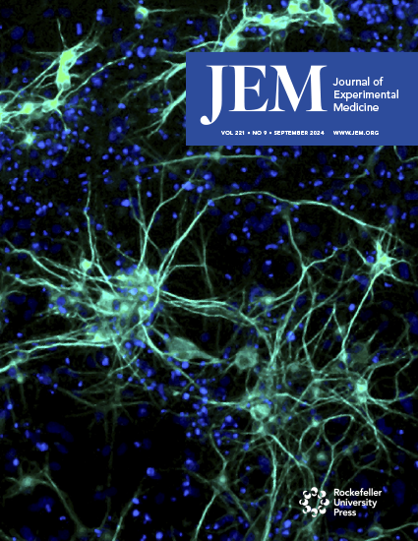
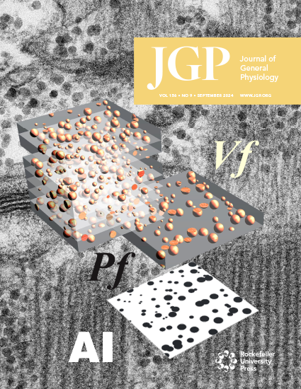

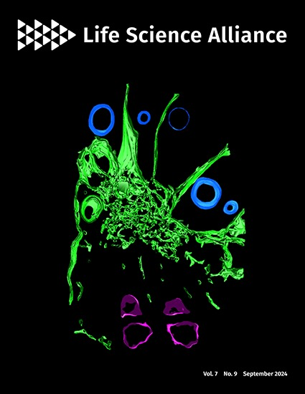

Rockefeller University Press
Department of Rockefeller University
Not a typical university press; No current book program
Five highly selective biomedical journals
3 Hybrid
2 Gold OA
Focus on quality metadata
ORCID, ROR, Funder Ds,, CRediT, OA Switchboard...

Slide 3
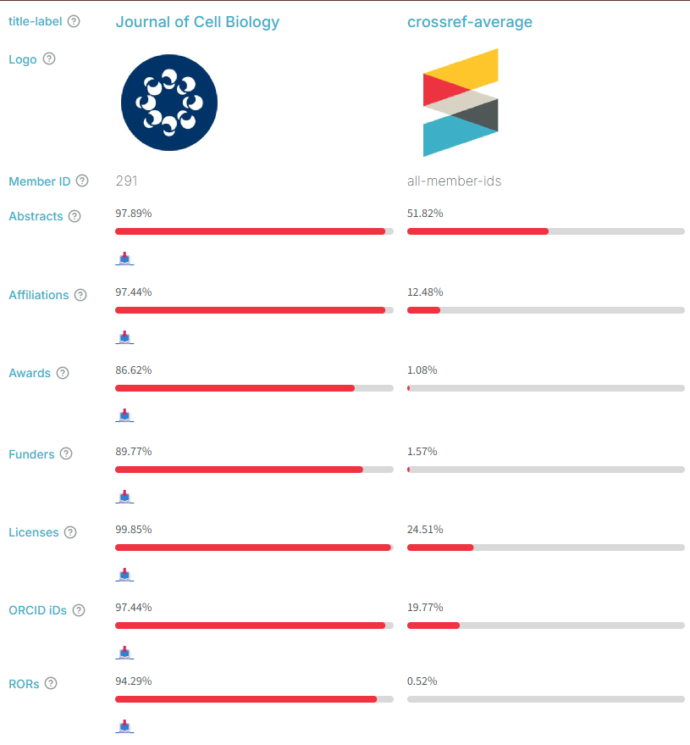
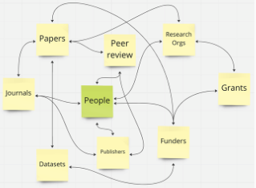
Image credit: Chris Shillum/ORCID

Slide 4
RUP ORCID Integration Journey
📅 2014: ORCID membership Optionally collecting authenticated ORCID IDs
🔄 2015: Crossref auto-update
✍️ 2016: Require ORCIDs for corresponding authors
⭐ 2019: ORCID reviewer credit
👥 2019: ORCID required for all authors
➡️ 2021: All ORCIDs sent to PubMed with article metadata
🤝 2024: Co-reviewer credit

Slide 5


Authenticated Collection
On submission
Throughout the review process
Requirement enforced prior to acceptance

Slide 6
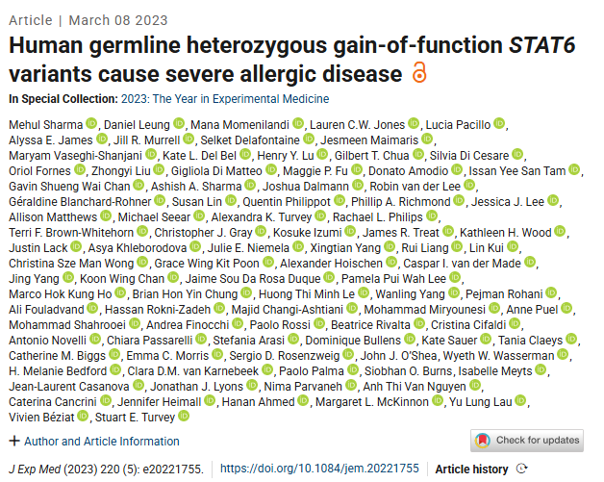

Slide 7
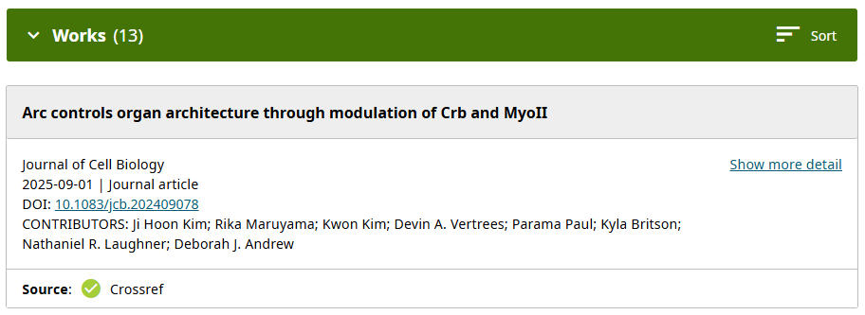

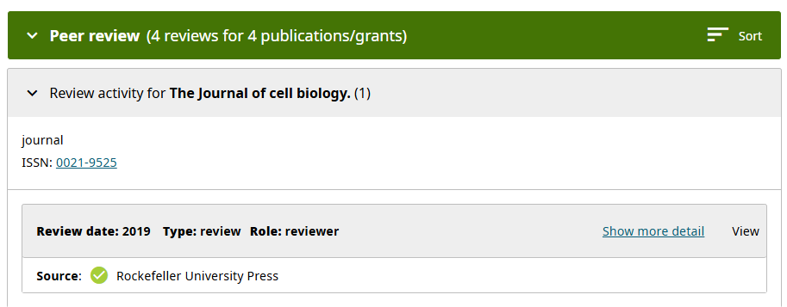
ORCID record updates

Slide 8
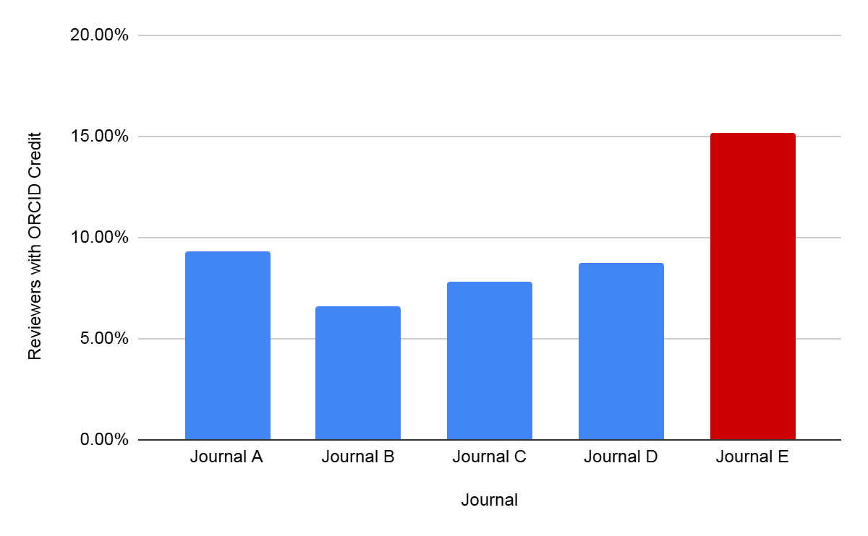
Reviewers with ORCID credit
Blue journal reviewers: >40% PIs with 16+ years of experience
LSA (red): Relies in many early-career and globally diverse reviewers
Co-reviewers are also included in these numbers

Slide 9
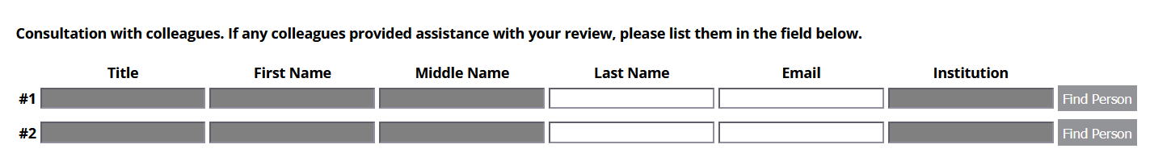
Co-reviewers
Upon returning their review, reviewers are asked if any colleagues aided with the review
If it doesn’t already exist, a record is created for the co-reviewer
They are offered the same reviewer credit opportunity as the main reviewers
More info: https://rupress.org/pages/co-reviewer-recognition

Slide 10
In summary The Importance of Verified Reviewer Credit via ORCID Members
Researchers get recognition for their peer-review contributions
Displays verified engagement within the academic community
Builds trust and credibility
From a recent ORCID LinkedIn post:
🆔 Assertions made by trustworthy member organizations are the most powerful Trust Markers you will find in an ORCID record. Viewing a researcher's full Record Summary can better surface the Trust Markers to help you make decisions about the trustworthiness of the record.
https://www.linkedin.com/posts/orcid_university-email-addresses-no-longer-effective-activity-7376320027299356672-Dt1T/

Slide 11
Questions?
odonner@rockefeller.edu

